Slide 1
B.COM 1
Unit 3
BY JAHANAVI DEO
DEPARTMENT OF COMMERCE
M.L ARYA COLLEGE,KASBA

Slide 3
Demand
Demand
Desire for commodity
Willingness to pay
At given price
Ability to pay
In given period of time

Slide 4
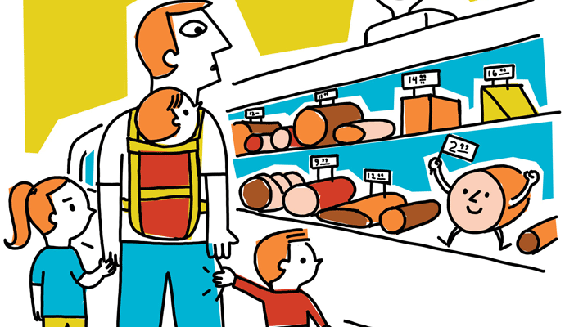
Demand is combination of all of the above five elements.
When a person has desire for any commodity, he /she has ability to pay for it also he/she is willing to bear the cost at a given price in a given period of time ,this is called demand.

Slide 5
Suppose a person has desire to buy a shirt which costs rs.1000. he has ability to pay the price but he is not willing to bear the cost as he thinks that the cost of shirt should be less the rs.1000 .in this case it will not be the case of demand.
The same case is with each of the element of demand. If any one of them is missing it will not reffered as demand.

Slide 6
Demand is the quantity of a good or services that consumers are willing and able to buy at a given price in a given time period.
It is always related to price and time.
Demand
Individual demand
Market demand

Slide 7
Individual demand.
It refers to demand from indivividual/ family/ household.
Price | Quantity
10 | 60
20 | 40
30 | 20

